Slide 1
RSA Authentication
with restful web services

Slide 2
Traditional username and password combination
Most widely used
Generate valid token and session when user logged in.
Esay to attack，once the password has been intercepted or leaked, or even guessed by trying all possible combinations

Slide 3
RSA(Why RSA ?)
Message, if intercepted, will not cause further security issue.
Public key is used for encryption and private key decryption (kept at the client side)
Analogy: Mailbox (RSA Encryption) & Stamp (Digital signature)

Slide 4
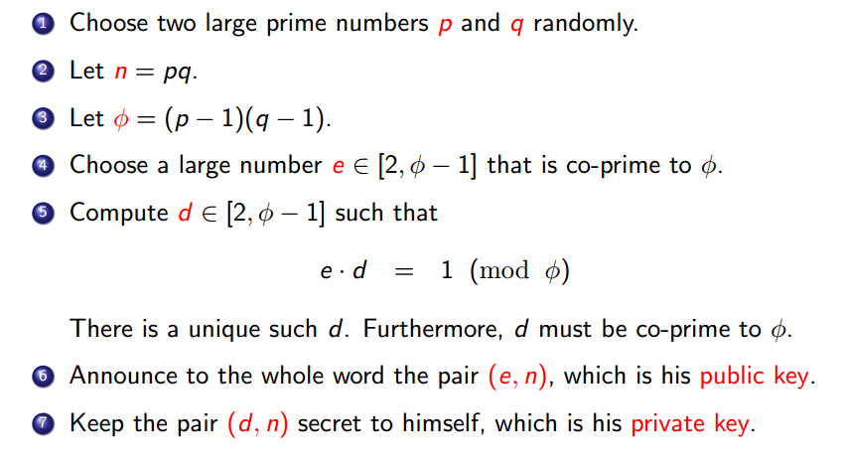
How it works?
Example:

Slide 5
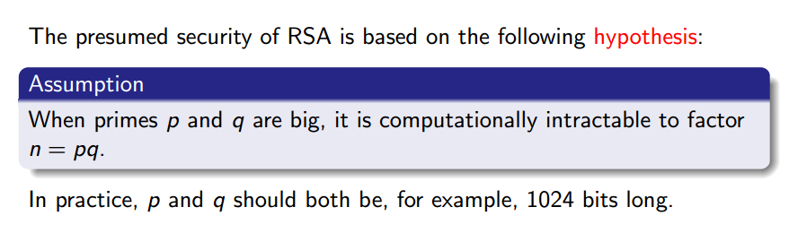
Why it works?

Slide 6
Integrated with Rest Protocol

Slide 7
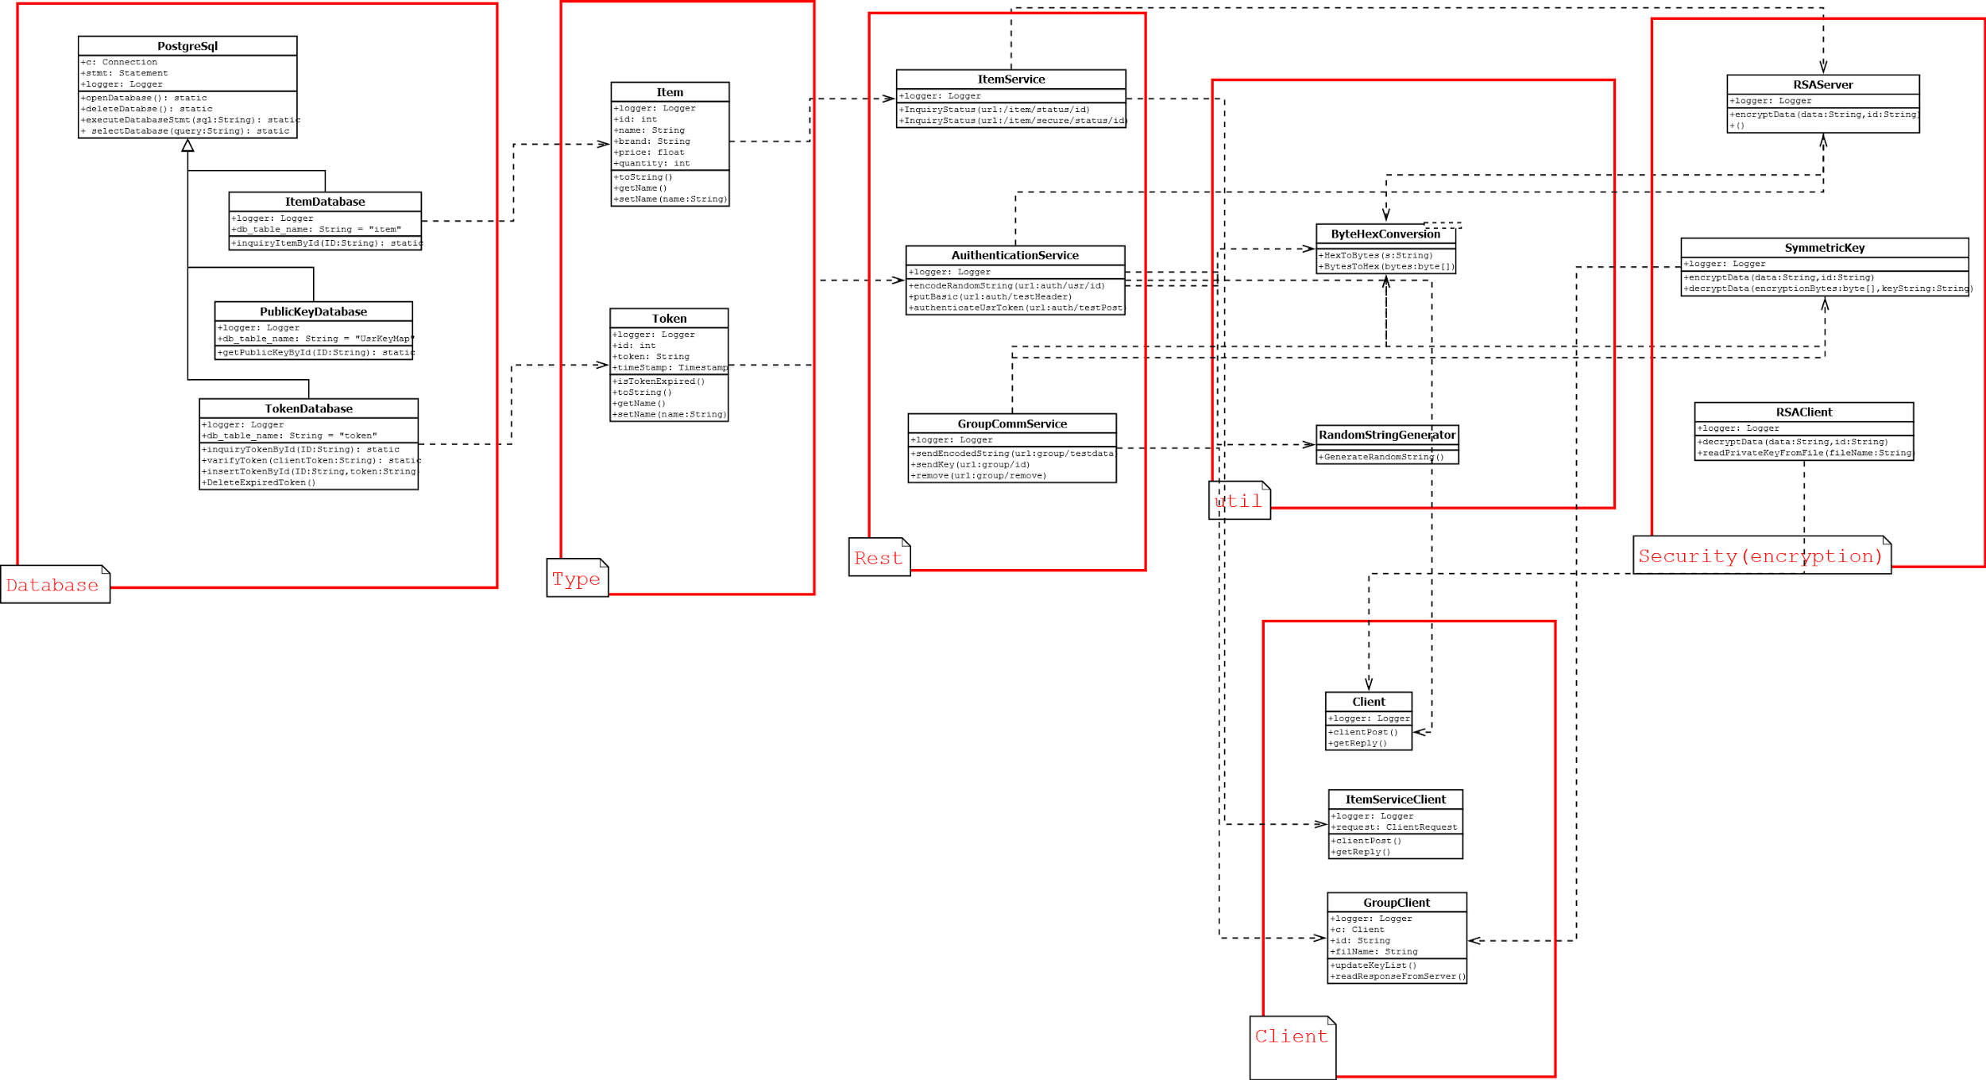
Class Diagram

Slide 9
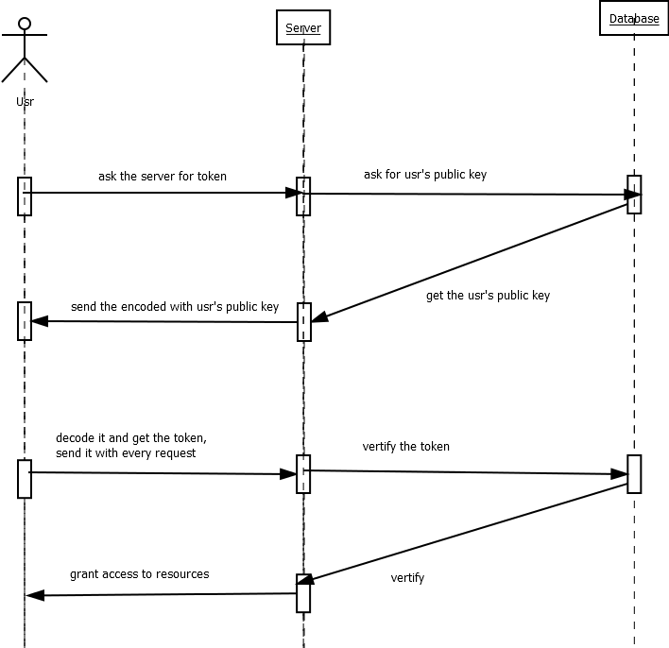
User Authentication
i

Slide 10
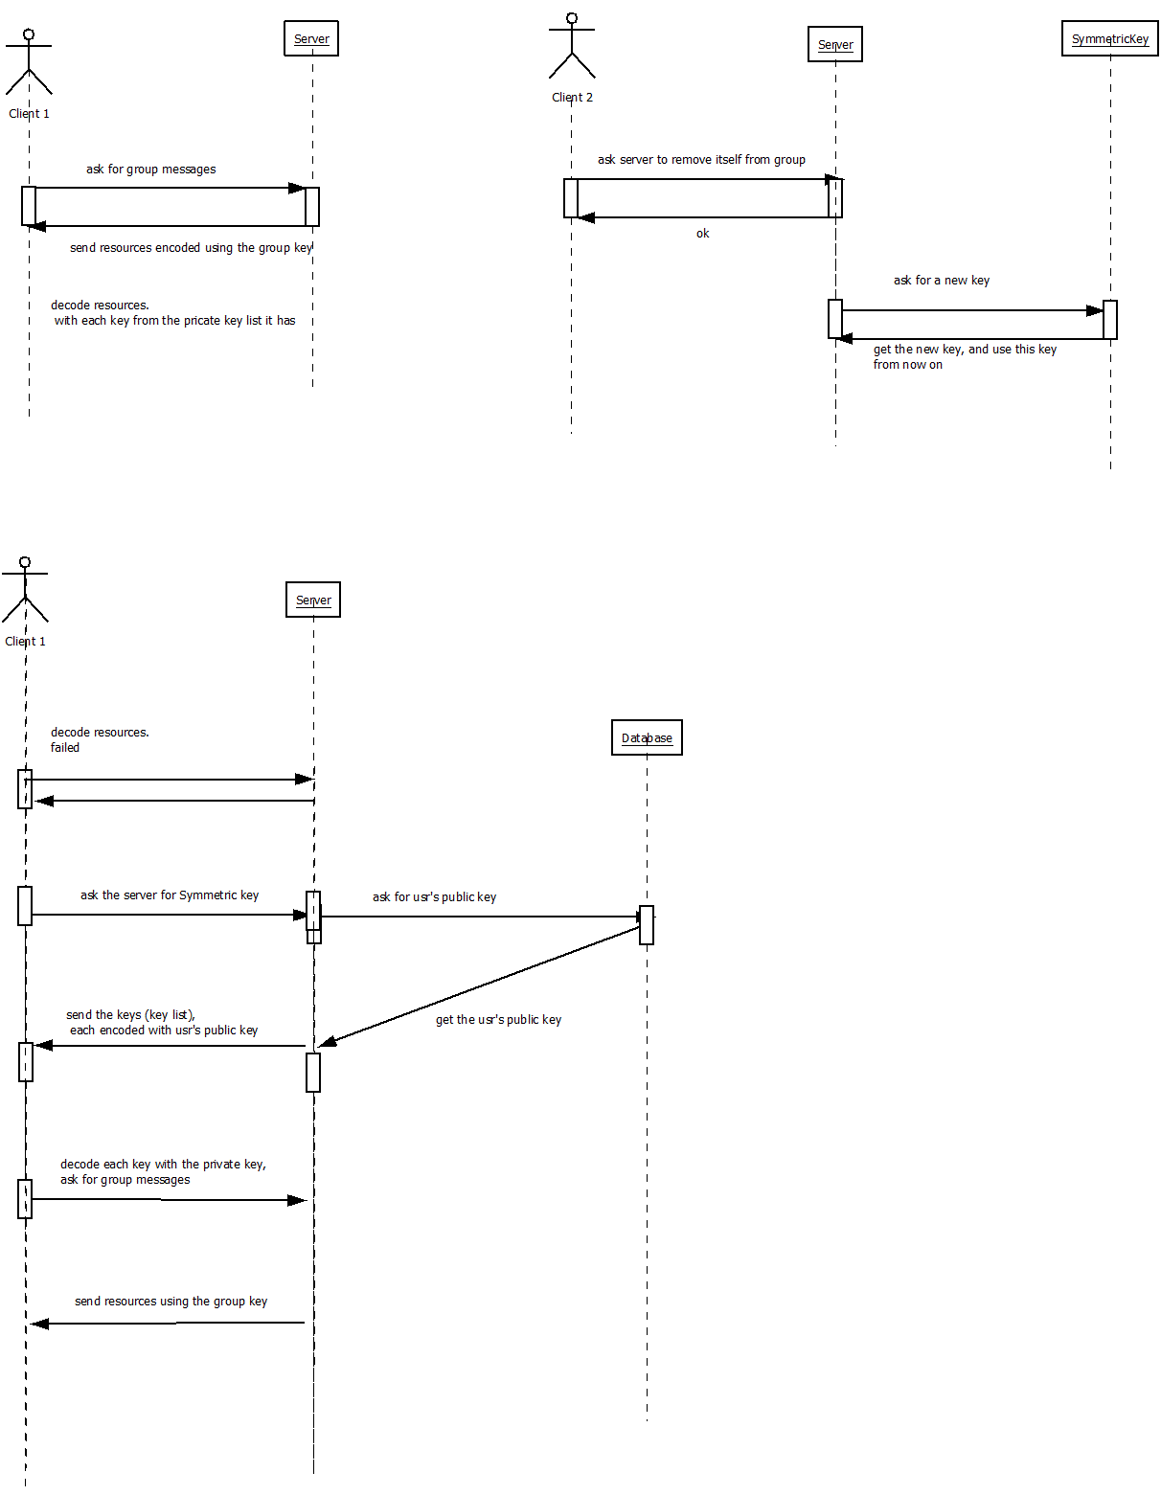
Group Communication

